Slide 1
Surgical affection of the soft and hard palate
Dr.Alaa A.Ibrahim

Slide 2
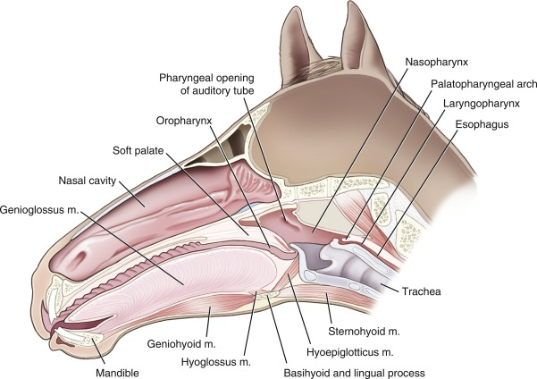
Anatomical concerne
The palates play important roles in swallowing and breathing

Slide 3
Surgical affections of the soft and hard palate
Cleft palate or palatoschisis,
acquired oronasal fistula
Lampas or palatitis or Lampers
Neoplasia
Protrusion of soft palate.

Slide 4
Cleft palate (palatoschisis)
Is abnormal communication between oral and nasal cavities involving these structures: soft palate , hard palate , premaxilla and with or without lips cleft.
Cleft palate present at birth
Primary cleft or cleft lip (harelip) :- is incomplete closure of lips and premaxilla which is represent primary palate
Not always recognized immediately. Brachycephalic breeds are more commonly affected. In cats siameese breed is usually affected.
Nasal regurgitation of milk during or after nursing, respiratory infection and failure to thrive are the major problems associated with this condition

Slide 5
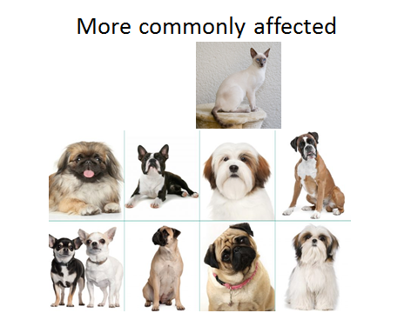

Slide 6
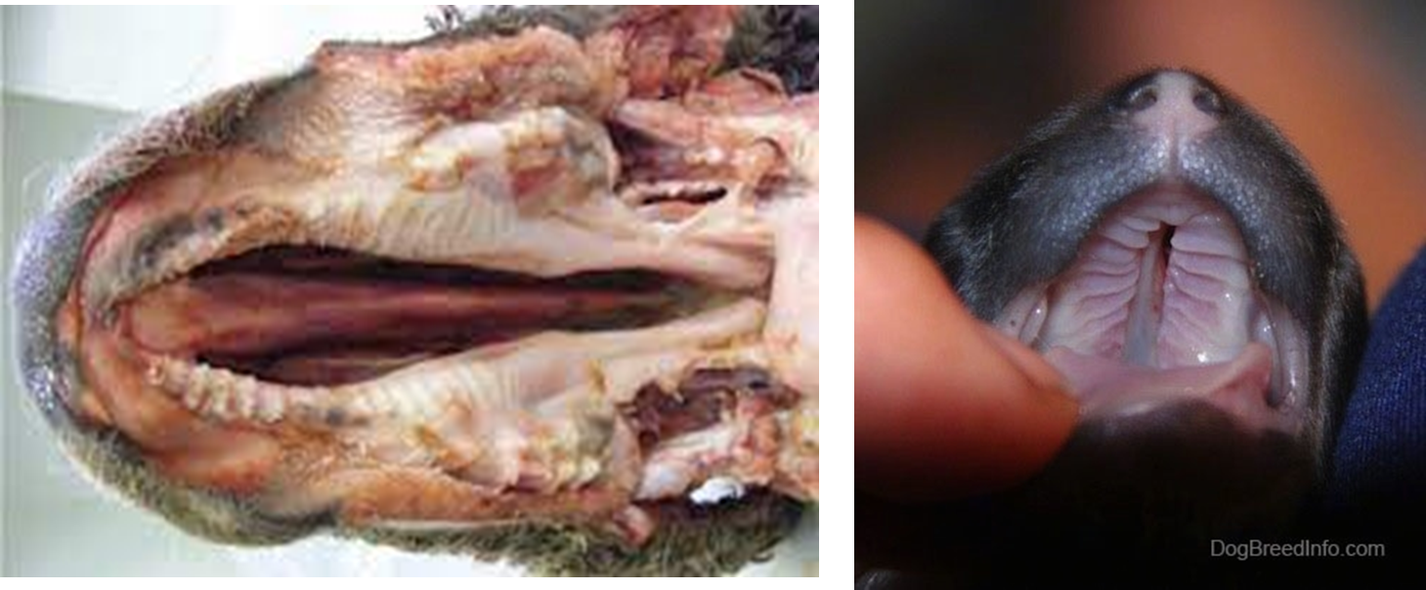
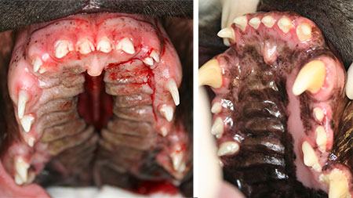

Slide 7
Causes of cleft palate
Congenital (incomplete fusion of the palatal folds following descent of the tongue in the mouth in early embryonic state)
Acquired (complete laceration of the palate may be created by inappropriate delivery of the oral medication)

Slide 8
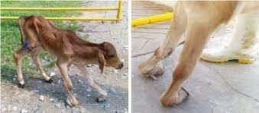
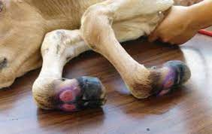
3-Ingestion of teratogenic substances such as piprodine alkaloids which are present in various plants which believed decrease fetal movement (tongue, and limb ) leading to cleft palate formation and flexor tendon contracture

Slide 9
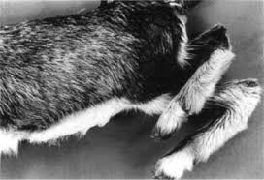
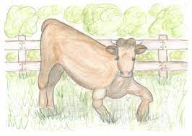
4-Cleft palate could be inherited in Charolais and Hereford calves.It is associated with other skeletal malformations such as arthrogryposis ( اعوجاج المفاصل )In cattle , usually soft and hard palate are involved and the defect is large which complicates surgical correction

Slide 10
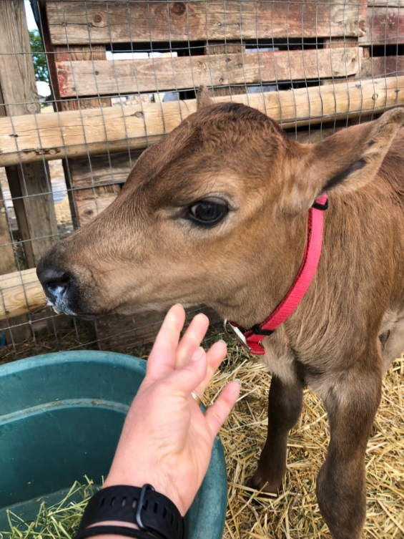
Clinical signs of cleft palate
Nasal regurgitation of milk during or after nursing, respiratory infection and failure to thrive are the major problems associated with this condition
There will be incomplete closure of the lips, incomplete closure of the premaxilla, hard palate, or soft palate

Slide 11
Diagnosis obtain at a very young age because the signs appear early in life .
1- Oral examination 2)- By nasopharyngeal endoscopy

Slide 12
Treatment options of the cleft palate
Euthanasia is first option in case of multiple congenital anomalies or with sever aspiration pneumonia
Surgical correction
Medical therapy won’t allow the animal to grow and develop normally because of frequent involvement of both palates

Slide 13
Treatment of the cleft palate
The owner should be informed of high rate of failure associated with repair of large cleft palate and the possible postoperative complications such as aspiration pneumonia, dysphagia, osteomyelitis , and cellulitis
Some cases need multiple surgeries to successfully close of cleft .30% of calves will have a positive outcome following surgical repair.
Surgical repair in calves is not delayed as it might be in horse because of risk of aspiration pneumonia and necessity of doing the surgery before the calves becomes a true ruminants.

Slide 14
Treatment of the cleft palate
• Tube feed the animal (via esophagostomy or gastrostomy tube) to maintain an adequate nutritional status and to reduce the incidence of aspiration pneumonia until they are old enough for surgery.
Surgery is performed when the animal is above 2 months of age, because the puppies will be better able to metabolise the anesthetic drugs and hence lesser anesthetic risks

Slide 15
Treatment of the cleft palate surgical options
Transoral
Bilateral buccotomy
Pharyngotomy a split of the basihyoid bone is used to repair a cleft involving the caudal third of the soft palate
Mandibular symphysiotomy
Symphysiotomy is the most frequent used method in cattle and it involve correction of both hard and soft palates( provides the best exposure to the soft and hard palate)

Slide 16
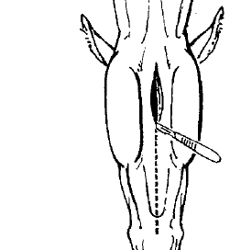
Surgical technique:- Symphysiotomy
Dorsal recumbency under general anesthesia
Tracheotomy and endotracheal tube is placed in the trachea
Ventral midline incision is
performed from basihyoid bone to the tip of lower lips .
The lips can be separated by using transverse skin incision and then the lips pushed dorsally in the oral cavity

Slide 17
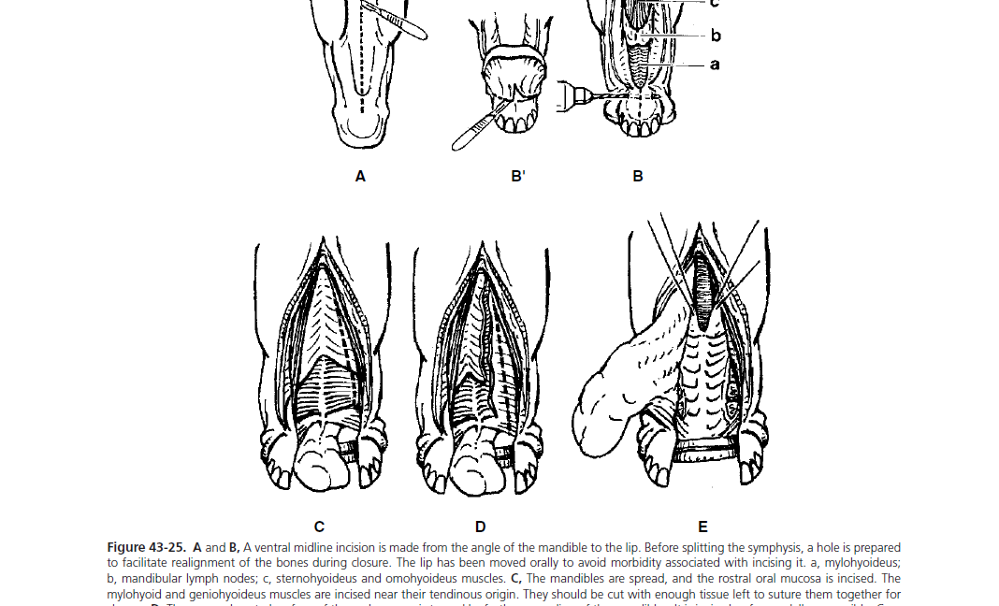

Slide 18
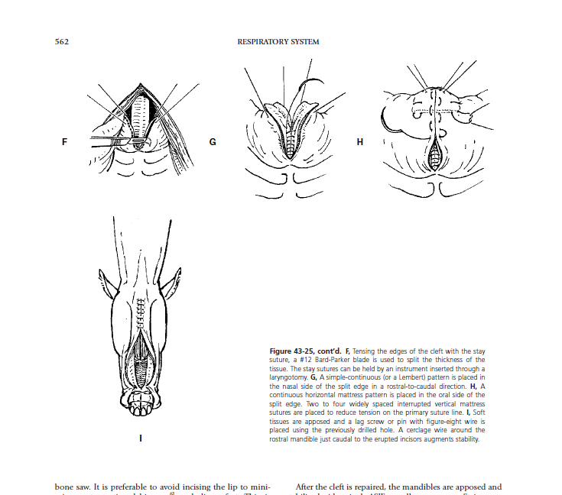

Slide 19
Techniques of closure of Hard palate defects by surgery-
Sliding bipedicle flap technique
Overlapping flap technique

Slide 20
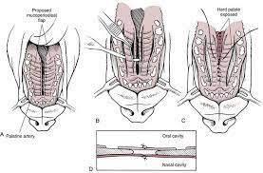
Sliding bipedicle flap technique
In Sliding bipedicle flap technique, mucoperiosteal incisions are made on either side of the cleft and the mucoperiosteum is elevated from the hard palate with the major palatine artery.
The nasal mucosa and mucoperiosteum are then apposed in two layers over the defect in the hard palate

Slide 21
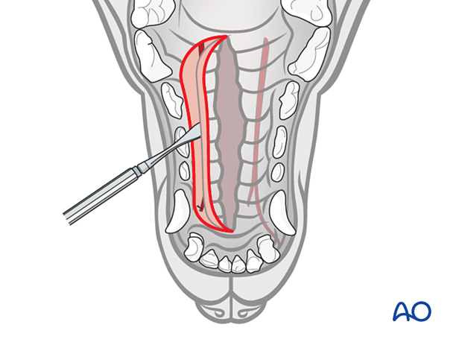
Overlapping flap technique
Mucoperiosteal flap is made on one side of the cleft, and rotated medially to cover the hard palate defect.
The edge of this flap is inserted between the hard palate and the mucoperiosteum on the opposite side of the defect.
The flap is secured in position with horizontal mattress sutures. Lateral relief incisions are made to reduce tension on the repair

Slide 22
Closure of Primary clefts involving the lip, pre-maxilla and nostril-
A mucosal flap is created from the nasal wall and sutured to a labial mucosal flap to separate the nasal cavity from the oral cavity. The cleft lip is then repaired with one or a series of Z plasties

Slide 23
Complications and Prognosis of Cleft palate
Dehiscence and incomplete healing are the most common complications
Dehiscence of hard palate repair occurs due to excessive tension and motion of the tongue against the repair.
In case of repair of the lip, dehiscence occurs if the orbicularis oris muscle has not been apposed; which causes excess tension on the suture line during movement of the lip.
Late dehiscence occurs due to growth-induced stress on the repair and can be treated when the patient matures
Prognosis is good; however several operations may be required.

Slide 24
Lampas or Palatitis or Lampers
is the inflammatory ridge like thickening of mucous membrane of hard palate immediately posterior to the upper incisors in equines. Common in young horses during the development of teeth.
Cause: unknown.
Signs: may be decreased appetite and/or increased salivation.
Diagnosis: history, clinical signs.

Slide 25
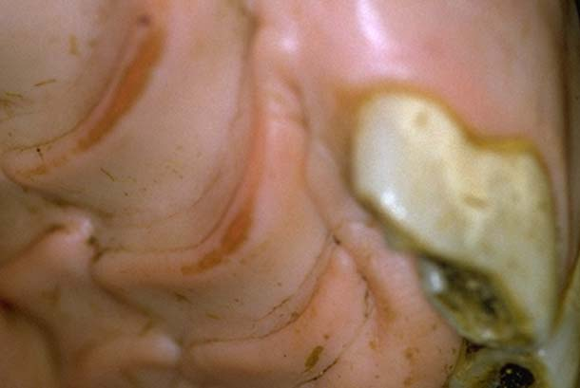
Treatment of Palatitis
Anti-inflammatory drugs, soft food should be advised.

Slide 26
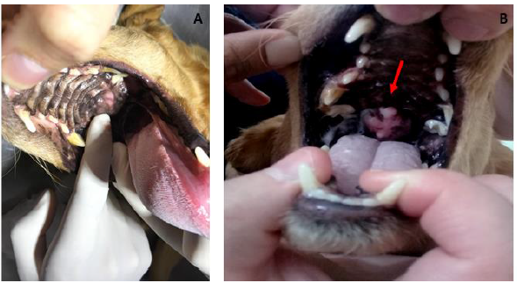
Neoplasia of palate
Squamous cell carcinoma of nasal maxillary sinus, Osteogenic sarcoma are common tumors of palate.
Epistaxis is common symptom in Neoplasia of palate in animals.

Slide 27
Protrusion of soft palate
Soft palate of male camel is distended by expiratory air and protrudes out of the oral cavity while creating oral sounds.
In the Arabian camel (Camelus dromidarius) the male undergoes a number of changes during the rut(mating season ) which, in northern India, occurs between November and March
he changes seen in males during the rut include an increase in testicular size, secretion from poll glands, frequent urination with tail flicking, vocalisation and bad temperedness, and the inflation of a diverticulum of a part of the soft palate, known as the (dulaa), into a large bladder which may protrude th rough the mouth

Slide 28
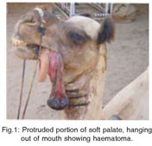
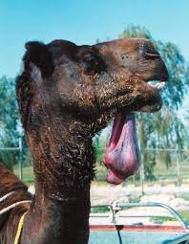
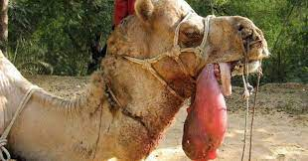
Injuries by molars or canines or violence that leads to bleeding and submucosa hematoma, ultimately this leads necrosis and gangrene
Treatment of Protrusion of soft palate
Amputation of the affected part is done to treat protrusion of soft palate.

